Slide 1


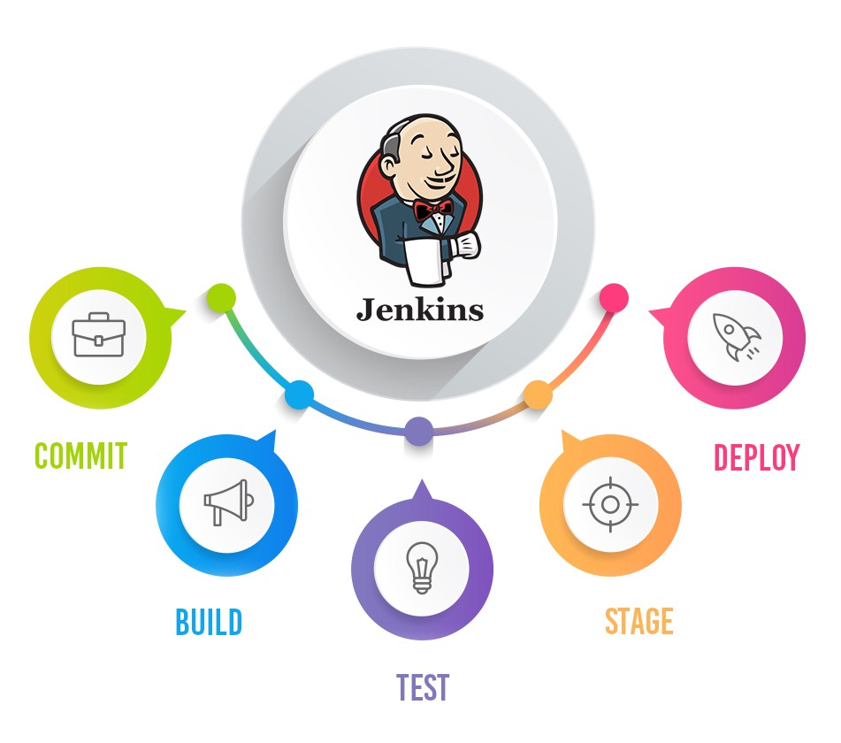
Jenkins Mastery for Software Tester
Pramod Dutta
Adding Git Repo and Other Stuff

Slide 2

Lets See Jenkins Job Demo
Demo Jenkins job

